Slide 1
Advanced Artificial Neural Networks
For Slides Thanks to
Dr. Nabeela Kausar

Slide 2
Introduction to machine Learning

Slide 3
Learning is any process by which a system improves performance from experience.”• “Machine Learning is concerned with computer programs that automatically improve their performance through experience. “

Slide 4
Traditional Programming
Machine Learning
Data
Computer
Output
Program
Data
Computer
Program
Output

Slide 5
The machine learning framework
y = f(x)
Training: given a training set of labeled examples {(x₁,y₁), …, (x_{N},y_{N})}, estimate the prediction function f by minimizing the prediction error on the training set
Testing: apply f to a never before seen test example x and output the predicted value y = f(x)
output
prediction function
Image feature
Slide credit: L. Lazebnik

Slide 6



The machine learning framework
Apply a prediction function to a feature representation of the image to get the desired output:
f( ) = “apple”
f( ) = “tomato”
f( ) = “cow”
Slide credit: L. Lazebnik

Slide 7
Biological Inspiration of Neural Network
The brain consists of a large number (approximately 10¹¹) of highly connected elements or cells called neurons. There are approximately 10⁴ connections per element
Neuron has three parts
Dendrites
Cell body
Axon

Slide 8
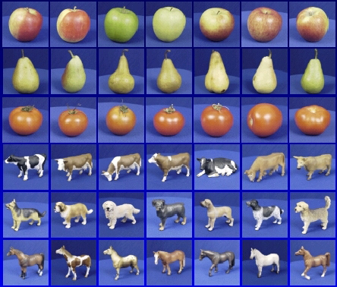

Steps
Training
Training Labels
Training Images
Image Features
Training
Learned model
Testing
Image Features
Learned model
Prediction
Test Image
Slide credit: D. Hoiem and L. Lazebnik

Slide 9
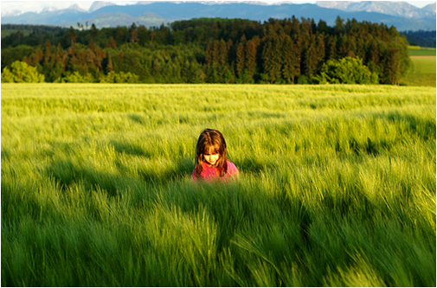
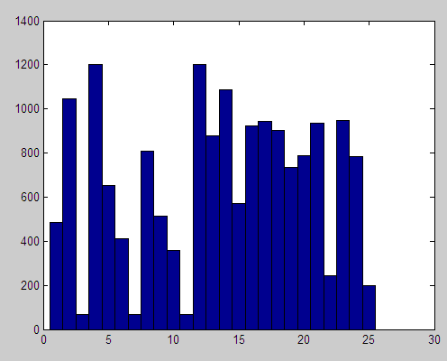

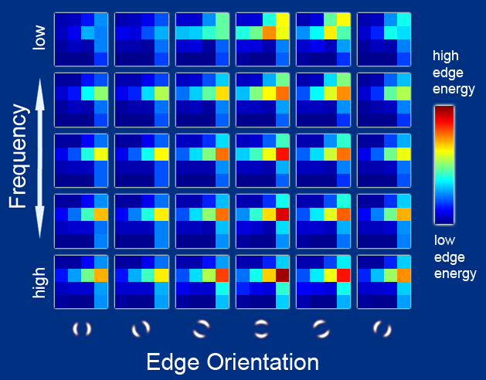
Features
Raw pixels
Histograms
GIST descriptors
…
Slide credit: L. Lazebnik

Slide 10
Classifiers: Linear
Find a linear function to separate the classes:
f(x) = sgn(w ⋅ x + b)
Slide credit: L. Lazebnik

Slide 11
Many classifiers to choose from
SVM
Neural networks
Naïve Bayes
Bayesian network
Logistic regression
Randomized Forests
Boosted Decision Trees
K-nearest neighbor
RBMs
Etc.
Which is the best one?
Slide credit: D. Hoiem

Slide 12
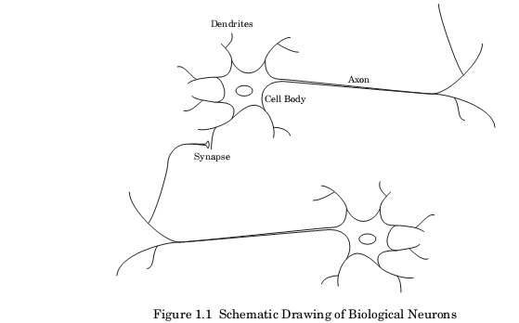

Slide 13
Introduction to Neural Network
An Artificial Neural Network (ANN) is a computational model that is inspired by the way biological neural networks in the human brain process information.

Slide 14
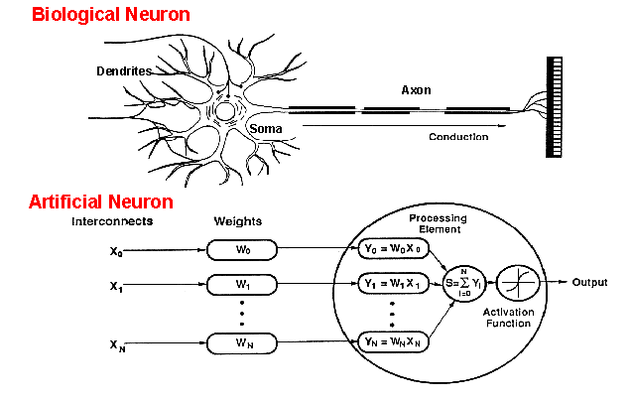
How do ANNs work?
An artificial neuron is an imitation of a human neuron

Slide 15
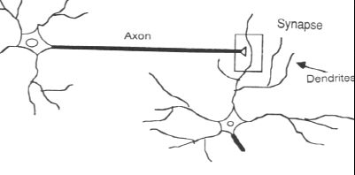
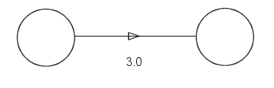
Synapse vs. weight

Slide 16
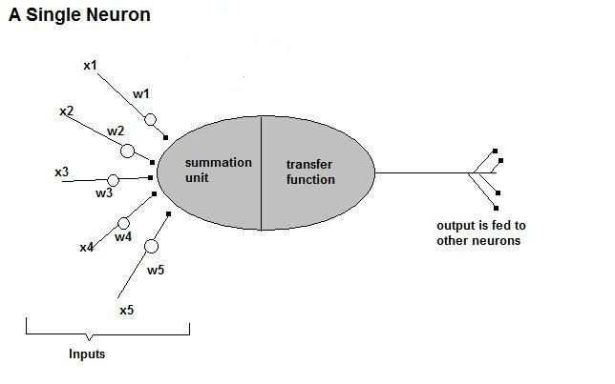
How do ANNs work?
• Now, let us have a look at the model of an artificial neuron.

Slide 17
How do ANNs work?
Input
xm
. . . . . . . . . . . .
x2
x1
Processing
∑
∑= X₁+X₂ + ….+X_{m} =y
Output
y

Slide 18

How do ANNs work?
Not all inputs are equal
xm
. . . . . . . . . . . .
x2
x1
Input
w_{m}
w₂
w₁
weights
. . . . .
Processing
∑
∑= X₁w₁+X₂w₂ + ….+X_{m}w_{m} =y
Output
y

Slide 19

How do ANNs work?
The signal is not passed down to the
next neuron verbatim
xm
. . . . . . . . . . . .
x2
x1
Input
w_{m}
w₂
w₁
weights
. . . . .
Processing
∑
Transfer Function (Activation Function)
f(v_{k})
Output
y

Slide 20
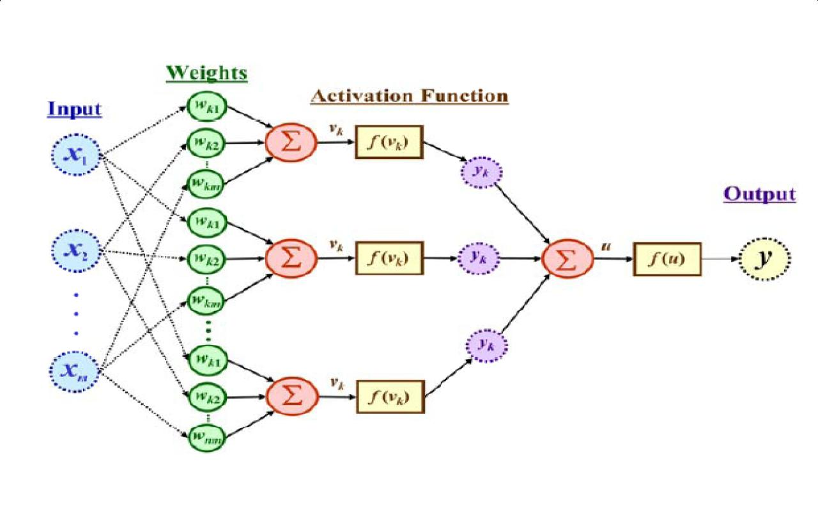
The output is a function of the input, that is affected by the weights, and the transfer functions

Slide 21
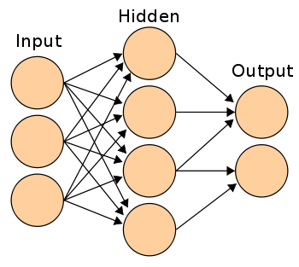
Three types of layers: Input, Hidden, and Output

Slide 22
Neuron Model and Network Architectures
Precptron
Preceptron is a neuron (It models a neuron)
It receives n inputs (corresponding to features)
It sums the input, checks the results and produces the output
It is used to classify the linearly separable data.

Slide 23
Preceptron Consist of
Input
Weights
Summation processor
Activation Function (It does thresh holding)
A preceptron takes weighted sum of inputs and outputs 1 if the sum is greater than some thresh hold and 0 otherwise
W1.x1+w2.x2+w3.x3+w4.x4 >0 then 1
W1.x1+w2.x2+w3.x3+w4.x4 <0 then 0
Another input is bias

Slide 24
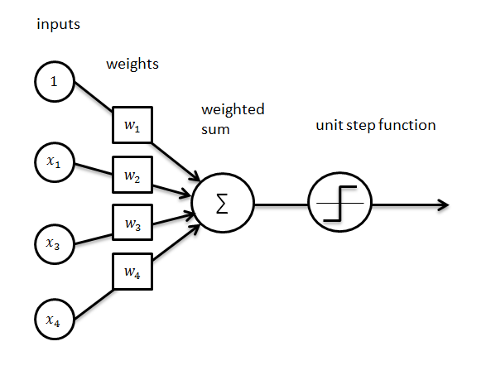
Single layer perceptron

Slide 25
Bias: Allows us to shift transfer function curve horizontally along the input axis while leaving the shape of the curve unaltered
Weights: determine the slope

Slide 26
Transfer Function: translates the input signals to output signals
It uses thresh holding to produce the output
Four types of Transfer functions are commonly used
Unit step
Sigmoid
Piece wise linear
Gaussian

Slide 27
Learning Rate: We would like to update the weight and bias to get the smaller error.
The learning rate helps us to update how much to change weight and bias (here derivative is used)

